Slide 1
Rank3 code analysis

Slide 2
Why rank3?
rank1 and rank3 use same algorithm : lightRGM
rank2 uses “RF”(Random Forest)
So we focus on lightRGM algorithm
Also, rank3’s code is more easier than rank1’s thing.

Slide 3
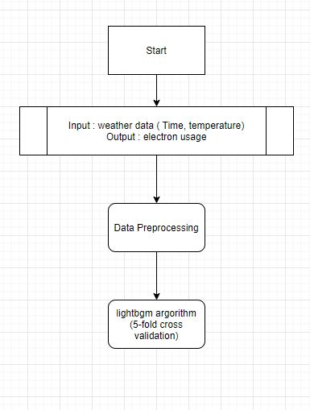
Full Algorithm

Slide 4
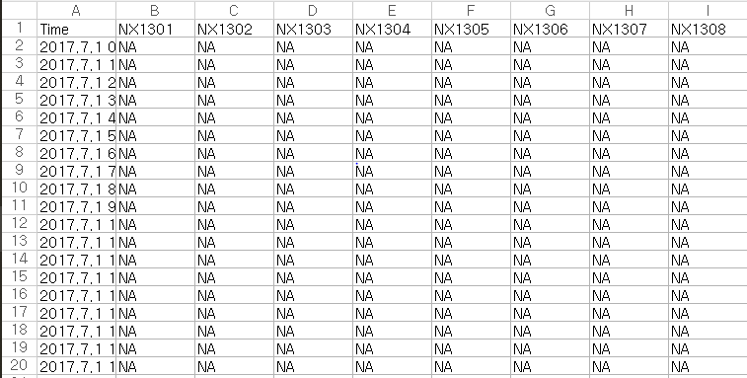
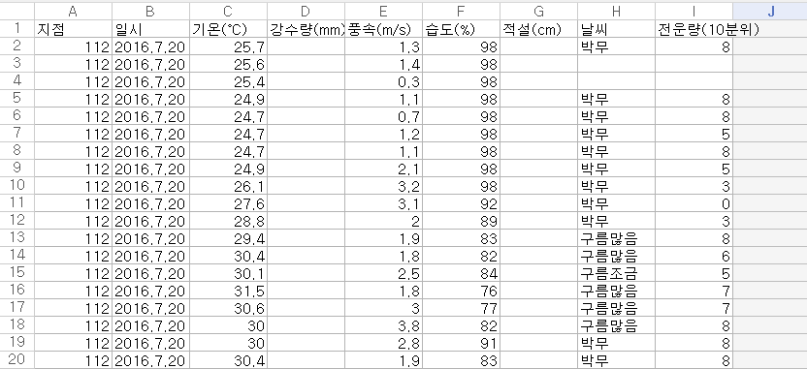
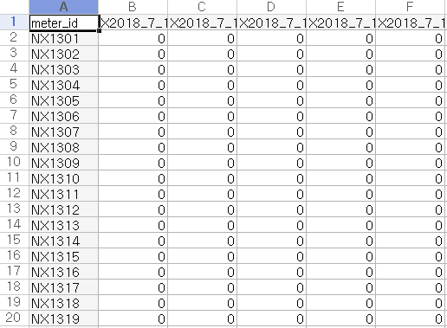
Data
Test data
Weather data
Submission data

Slide 5
Data preprocessing & Feature Engineering
test dataset : Time
Submission dataset : meter_id
submission의 meter_id = test data’s schema
meter_id : B~GS column
Time | meter_id(target) | weather (temperature) | month | week | weekday | day | hour | holiday | weekend | is_holiday | date | tomorrow
time series | int | float | int | int | int | int | int | int | 0, 1 week :0 weekend :1 | 0, 1 not holiday :0 holiday :1 | series | series

Slide 6
Case
include temp and hour predict
exclude temp and hour predict
exclude temp and day, month predict

Slide 7
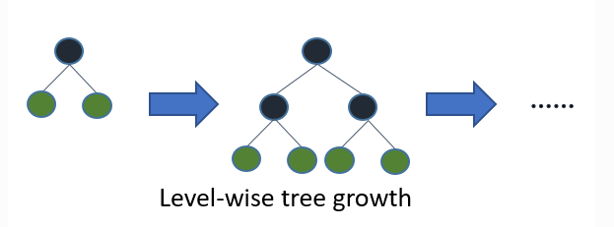
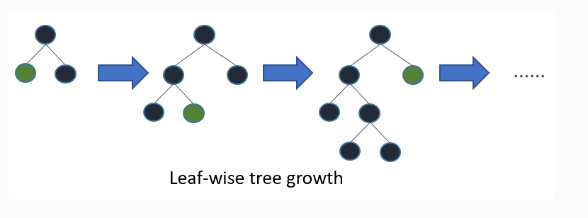
ML Algorithm - lightGBM
Decision tree boosting algorithm
(1)(2)

Slide 11
Reference
Guolin Ke, Qi Meng, Thomas Finley, Taifeng Wang, Wei Chen, Weidong Ma, Qiwei Ye, Tie-Yan Liu. “LightGBM: A Highly Efficient Gradient Boosting Decision Tree.” Advances in Neural Information Processing Systems 30 (NIPS 2017), pp. 3149-3157.
Shi, Haijian. “Best-first decision tree learning.” Diss. The University of Waikato, 2007.

